Slide 1
CSE881 Project Presentation
Zhongzheng Chen and Chang Liu

Slide 2
Models
TFIDF and PCA/LDA
Naïve Bayes Classifier
DAN (Deep Averaging Networks)
Bidirectional LSTM Classifier
Ensemble method
Bagging

Slide 3
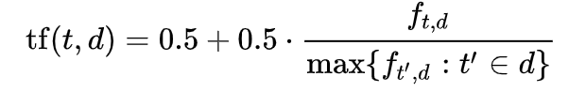
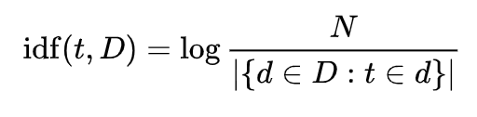

TFIDF and PCA/LDA
Model
PCA/LDA and KNN classification
Training
5 folds random cross-validation set
1 fold for validation
Validation Result
Highest accuracy is about 20%
TFIDF Calculation Equation

Slide 4
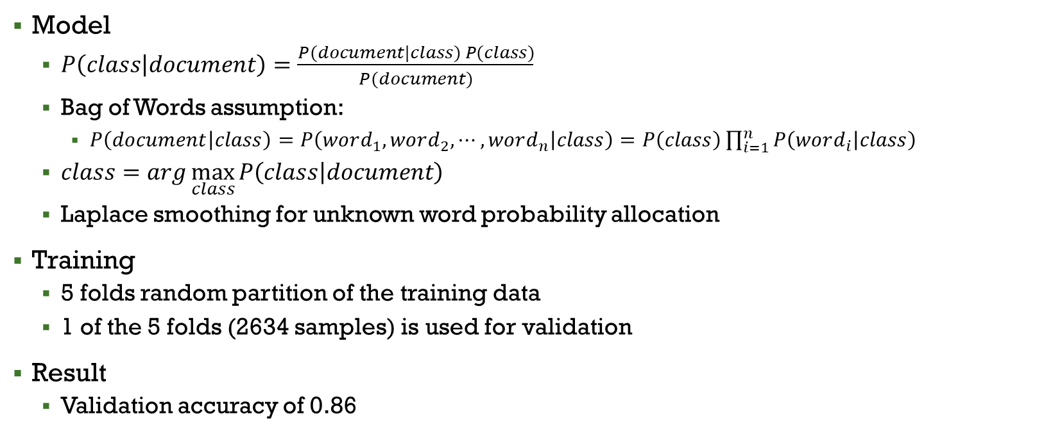
Naïve Bayes Classifier
Model
$P\left(class | document\right)=\frac{P(document|class) P(class)}{P(document)}$
Bag of Words assumption:
$P\left(document | class\right)=P\left(word_{1}, word_{2},⋯,word_{n} | class\right)=P\left(class\right)\prod_{i=1}^{n}{P\left(word_{i} | class\right)}$
$class=arg\max_{class}{P\left(class | document\right)}$
Laplace smoothing for unknown word probability allocation
Training
5 folds random partition of the training data
1 of the 5 folds (2634 samples) is used for validation
Result
Validation accuracy of 0.86

Slide 5
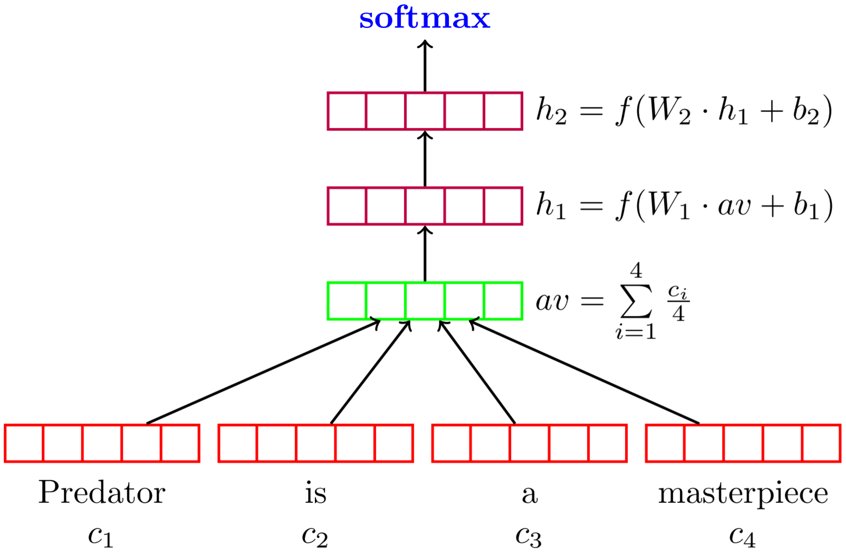
DAN (Deep Averaging Networks)
A simple feed forward network
Training
5 folds random partition of the training data
1 of the 5 folds (2634 samples) is used for validation
Training setup:
Epoch: 20
Batch size: 50
Learning rate: 0.01
Optimizer: Adam
Activation function: ReLU
Embedding size: 150
Hidden layer size: 100
Number of hidden fully connected layer: 3

Slide 6
DAN (Deep Averaging Networks)
Training results:
[01/20] train: loss : 2.87, acc: 19.73% | Val: mean_loss : 2.75, acc: 33.81%
[02/20] train: loss : 2.71, acc: 36.95% | Val: mean_loss : 2.76, acc: 31.53%
[03/20] train: loss : 2.66, acc: 41.33% | Val: mean_loss : 2.66, acc: 40.93%
[04/20] train: loss : 2.63, acc: 45.08% | Val: mean_loss : 2.65, acc: 43.35%
[05/20] train: loss : 2.63, acc: 46.15% | Val: mean_loss : 2.62, acc: 46.51%
[06/20] train: loss : 2.66, acc: 42.43% | Val: mean_loss : 2.69, acc: 40.28%
[07/20] train: loss : 2.64, acc: 45.78% | Val: mean_loss : 2.66, acc: 43.58%
[08/20] train: loss : 2.64, acc: 44.84% | Val: mean_loss : 2.69, acc: 40.19%
[09/20] train: loss : 2.65, acc: 44.19% | Val: mean_loss : 2.65, acc: 44.47%
[10/20] train: loss : 2.62, acc: 47.86% | Val: mean_loss : 2.74, acc: 35.35%
[11/20] train: loss : 2.70, acc: 39.66% | Val: mean_loss : 2.68, acc: 41.49%
[12/20] train: loss : 2.66, acc: 43.74% | Val: mean_loss : 2.65, acc: 44.74%
[13/20] train: loss : 2.68, acc: 41.40% | Val: mean_loss : 2.68, acc: 40.70%
[14/20] train: loss : 2.68, acc: 41.04% | Val: mean_loss : 2.68, acc: 41.49%
[15/20] train: loss : 2.68, acc: 40.76% | Val: mean_loss : 2.79, acc: 29.95%
[16/20] train: loss : 2.71, acc: 37.98% | Val: mean_loss : 2.81, acc: 28.09%
[17/20] train: loss : 2.73, acc: 36.57% | Val: mean_loss : 2.72, acc: 37.21%
[18/20] train: loss : 2.71, acc: 37.81% | Val: mean_loss : 2.66, acc: 42.93%
[19/20] train: loss : 2.64, acc: 44.83% | Val: mean_loss : 2.69, acc: 39.53%
[20/20] train: loss : 2.71, acc: 38.53% | Val: mean_loss : 2.76, acc: 33.44%

Slide 7
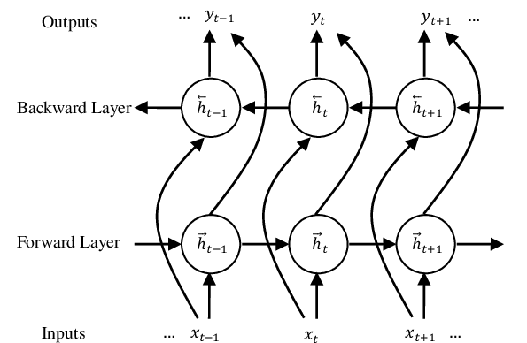
BLSTM
Training
5 folds random partition of the training data
1 of the 5 folds (2634 samples) is used for validation
Training setup:
Epoch: 20
Batch size: 50
Learning rate: 0.01
Optimizer: Adam
Activation function: ReLU
Embedding size: 100
LSTM hidden layer size: 100
Image taken from https://www.researchgate.net/figure/Architecture-of-BLSTM_fig1_307889752

Slide 8
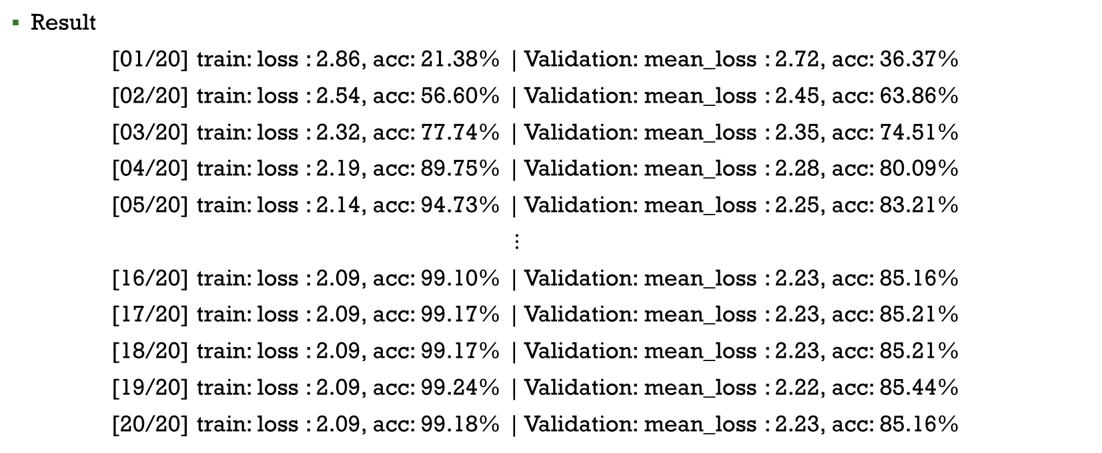
BLSTM
Result
[01/20] train: loss : 2.86, acc: 21.38% | Validation: mean_loss : 2.72, acc: 36.37%
[02/20] train: loss : 2.54, acc: 56.60% | Validation: mean_loss : 2.45, acc: 63.86%
[03/20] train: loss : 2.32, acc: 77.74% | Validation: mean_loss : 2.35, acc: 74.51%
[04/20] train: loss : 2.19, acc: 89.75% | Validation: mean_loss : 2.28, acc: 80.09%
[05/20] train: loss : 2.14, acc: 94.73% | Validation: mean_loss : 2.25, acc: 83.21%
$⋮$
[16/20] train: loss : 2.09, acc: 99.10% | Validation: mean_loss : 2.23, acc: 85.16%
[17/20] train: loss : 2.09, acc: 99.17% | Validation: mean_loss : 2.23, acc: 85.21%
[18/20] train: loss : 2.09, acc: 99.17% | Validation: mean_loss : 2.23, acc: 85.21%
[19/20] train: loss : 2.09, acc: 99.24% | Validation: mean_loss : 2.22, acc: 85.44%
[20/20] train: loss : 2.09, acc: 99.18% | Validation: mean_loss : 2.23, acc: 85.16%

Slide 9
Ensemble
Bagging
5 folds random partition of the training data
1 of the 5 folds (2634 samples) is used for ensemble validation
Another 5 folds random partition of the remaining 4 folds
4-fold (8429 samples) for model training
1-fold (2107 samples) for training validation.
Naïve Bayes Classifier
No significant improvement
BLSTM
Around 6-7% accuracy improvement
Combination of both
Around 2-3% accuracy improvement with 33 BLSTM models and 20 Naïve Bayes models
Around 6-7% accuracy improvement with 48 BLSTM models and 3 Naïve Bayes models (our current model)

Slide 10
Lessons learned
Naïve Bayes Classifier
Pro:
provides a solid baseline performance for document classification
Con:
the learned models are very consistent despite the randomness of training data partitioning and can’t be used for bagging ensemble method.
BLSTM
Pro:
good neural network model for document classification
learn different aspect from different initialization and data, which enable bagging ensemble for further improvement
Con:
requires more data for larger label size

Slide 11
Reference
Iyyer, H. (2015). Deep Unordered Composition Rivals Syntactic Methods for Text Classification. In Proceedings of the 53rd Annual Meeting of the Association for Computational Linguistics and the 7th International Joint Conference on Natural Language Processing (Volume 1: Long Papers) (pp. 1681–1691). Association for Computational Linguistics.
BLSTM image: https://www.researchgate.net/figure/Architecture-of-BLSTM_fig1_307889752

Slide 12
Thank you

